Slide 1
“Where Shall I Live When I Re-Locate?”
IBM Data Science Professional Certificate Capstone Project
- Matthew Calder

Slide 2
Overview
Introduction – What is the problem?
Data – What data was used to solve the problem?
Methodology – How was the problem solved?
Results – What do the results look like?
Future Work – How could the results be improve?
Conclusion

Slide 3
Introduction
Imagine you want to move to a new city
How do you decide what area of the city to live in?
Current Approach
For EVERY area:
Talk to the locals
Read anecdotal info
Scour the internet
This can be extremely time consuming if conducting for every area. What if we could filter out the rubbish, and focus on what we might like?
New Approach
Utilise the tool created here to down-select areas of interest based upon the category they are defined as. Once the areas of no-interest are filtered out carry out more detailed research if required.

Slide 4
Data
Three sources of data were used:
Venue information including location information, venue name, and venue category for venues around Great Britain.
Use – This information is used to compare different postcode districts by comparing the type and frequency of venues within a given postcode district.
Data – A list of longitudes/latitudes for all postcode districts in Great Britain.
Use – This is used to 1) input into the FourSquare API requests to receive the desired venue information, and 2) plot all postcode districts on a map to allow for easy visualisation of the final categories associated with their locations.
Data – A geojson file containing shape data for all the postcode areas within Great Britain.
Use – This is to be used to aid data visualisation only. These areas will be plotted on a map of Great Britain to aid the users understanding of the geography, but will also be used to split the map into discrete layers that the user can turn on/off depending on if they are interested in that area or not.
[1] https://developer.foursquare.com/
[2] https://github.com/roblascelles/uk-postcode-map/blob/master/data/uk-postcode-area.json
[3] https://www.freemaptools.com/download-uk-postcode-lat-lng.htm
Contains Ordnance Survey data © Crown copyright and database right 2020
Contains Royal Mail data © Royal Mail copyright and database right 2020

Slide 5
Methodology
District Location Data
Venue Information
Data
Clean-up
Cluster
FourSquare API
Area Shape Data
Results Visualisation
Note: More detailed information on methodology available at:

Slide 6
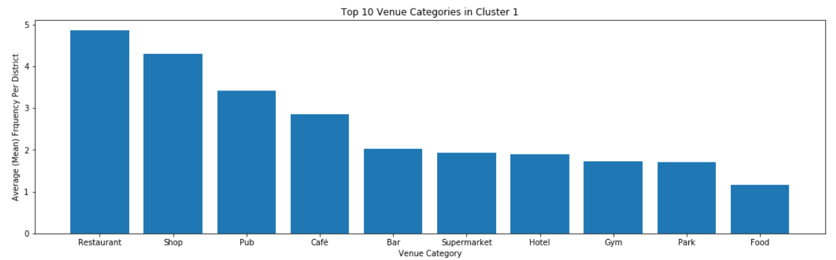
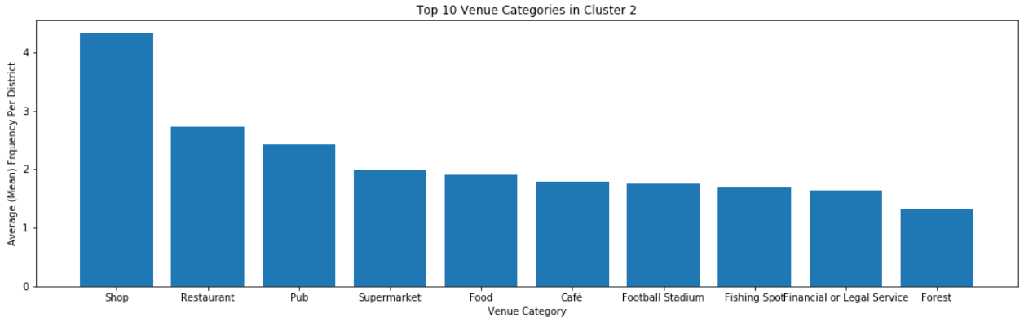
Results – Cluster Analysis

Slide 7
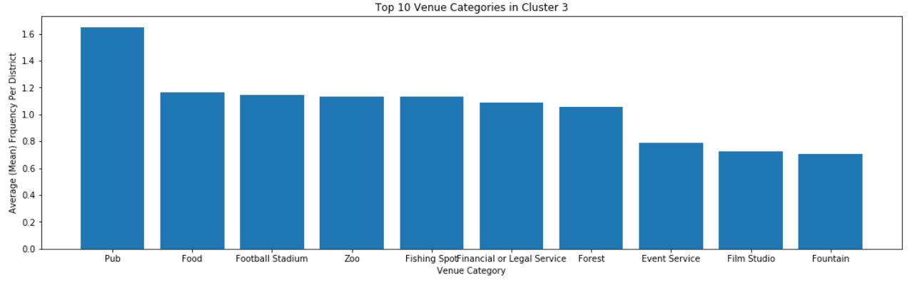
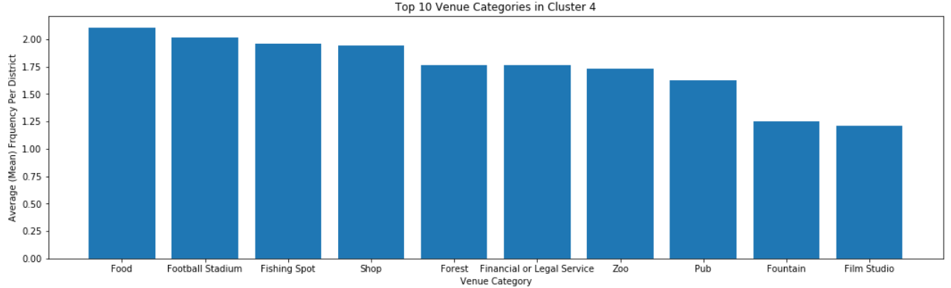
Results – Cluster Analysis

Slide 8
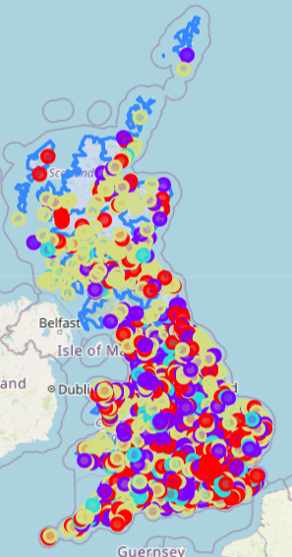
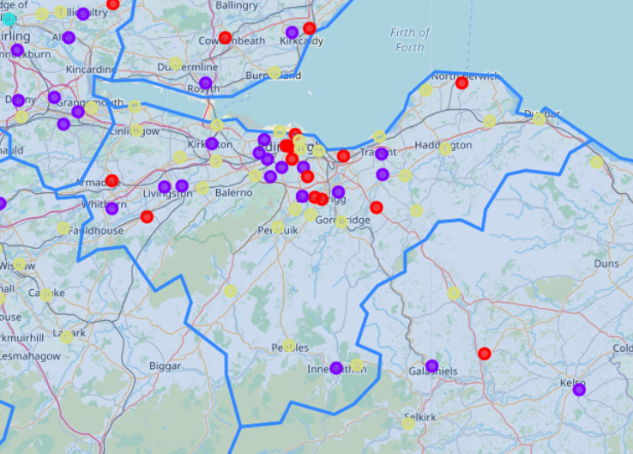
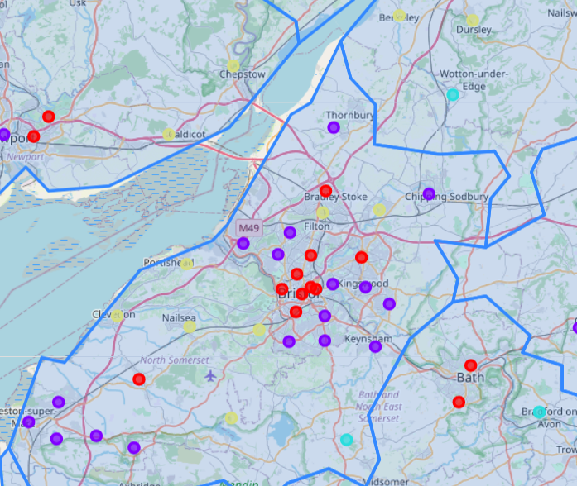
Results - Data Visualisation
High No. Eateries and Shopping
Medium No. Shopping and Eateries
Least Amount of Venues (Mainly Pubs)
Food and Outdoors
Edinburgh Vs. Bristol Example
Edinburgh Clusters
Bristol Clusters

Slide 9
Discussion
There are two major limitations that have been identified when creating and reviewing this model. These are:
A 1km circle around the centre of the postcode is used for all districts when identifying associated venues. In some cases this may be a good fit however in some larger districts this may not be sufficient. If this model was to be improved in the future it is recommended that a method of finding venues from all around the district (rather than just the centre) in a non-circular fashion is implemented.
Venue location only is used to categorise districts. The inclusion of housing prices, school information, infrastructure or other data-sources would increase the usefulness of this analysis for different stakeholders. Again, if this model is to be improved, future work is suggested to identify the major data sources that would affect stakeholders’ decision making the most, and implement these when creating the clusters.

Slide 10
Conclusion
A technique to compare all postcode districts within Great Britain has been presented in which these districts are categorised into 4 discrete categories:
High No. Eateries and Shopping
Medium No. Shopping and Eateries
Least Amount of Venues (Mainly Pubs)
Food and Outdoors
Future work has been suggested to improve the usefulness of the model
The current model can be used to help inform a first pass decision for interested parties on where they should consider further in an attempt to answer their question of “Where Shall I live When I Re-Locate?”.

